Slide 1
Stock Portfolio Suggestion Engine
Team Members:
Ramya Iyer (ID: 013312195)
Sanjna Dhamejani (ID: 013006721)
Sayalee Bhusari (ID: 013006461)

Slide 2
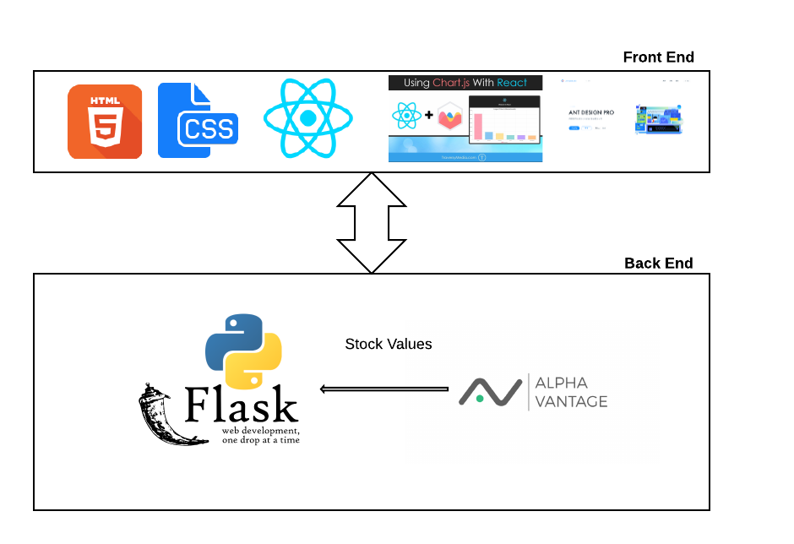
Architecture

Slide 3
Main Features
Amount of money : User is able to choose the amount of money he would invest.
Strategy Choice: User is allowed to choose one or two investment strategies from Ethical, Growth, Quality and Value Investing.
Suggest Stocks: The tool maps stocks based on selected strategies. These stocks are suggested per strategy.

Slide 4
Additional Features
User Chart JS for accurate graphical analysis
User Twitter bootstrap 4 for a user friendly and colorful UI
Used Alpha Vantage API for real time and historic stock data

Slide 5
Test Case ID | Input | Output
1. | $6000 and any one investing strategy selected | Investing report is generated
2 | $4000 and any one investing strategy selected | Error message – value must be greater than or equal to $5000
3 | Amount is Empty | Enter amount
4 | $8000 and any three strategies selected | Error Message – select max 2 options
5 | $6000 and no strategy selected | Error message – select at least one strategy
6 | $7000 and any two strategies selected | Investing report is generated
7 | $10000 and growth strategy selected | Investing report is generated
8 | $10000 and index strategy selected | Investing report is generated
9 | $10000 and quality strategy selected | Investing report is generated
10 | $10000 and value strategy selected | Investing report is generated

Slide 6
Challenges
Having no knowledge about stock market and investing strategies, it was challenging for our teammates. We had to research into how the strategies work and transfer those methods into code.
Searching appropriate APIs that would help us was a challenge. Many APIs listed on sites were either not working or were outdated

